Slide 1
Dobby Shedding

Slide 2
Climax Dobby

Slide 3
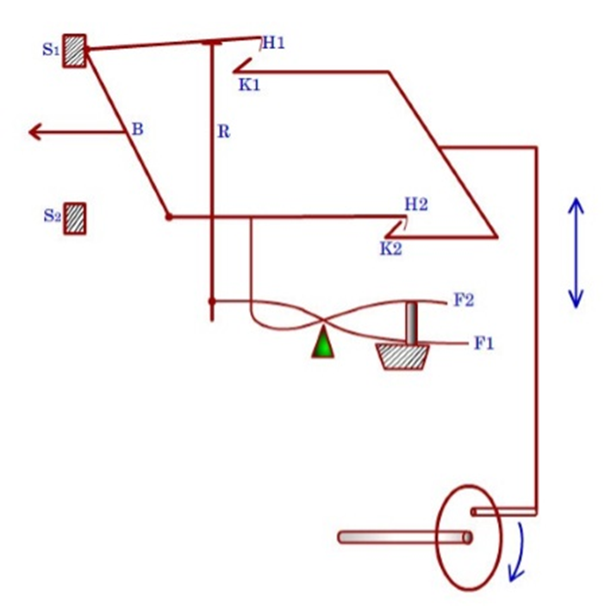
Keighley Dobby
Keighley dobby is known to be a double acting dobby as most of the operations is done at half speed as compared to the loom speed (picks per minute).
The basic components of Keighley dobby are as follows:
    Stop bars
    Baulk
    Hooks (two per heald)
    Knives (two for the entire dobby)
    Pegs on pattern chain
The motion to the reciprocating knives (K1 and K2) originates from the bottom shaft of loom.
As one revolution of bottom shaft ensures two picks, each of the two knives completes the cycle of inward (towards the left) and outward (towards the right) movements during this period.
The two reciprocating knives are in complete phase difference.

Slide 5
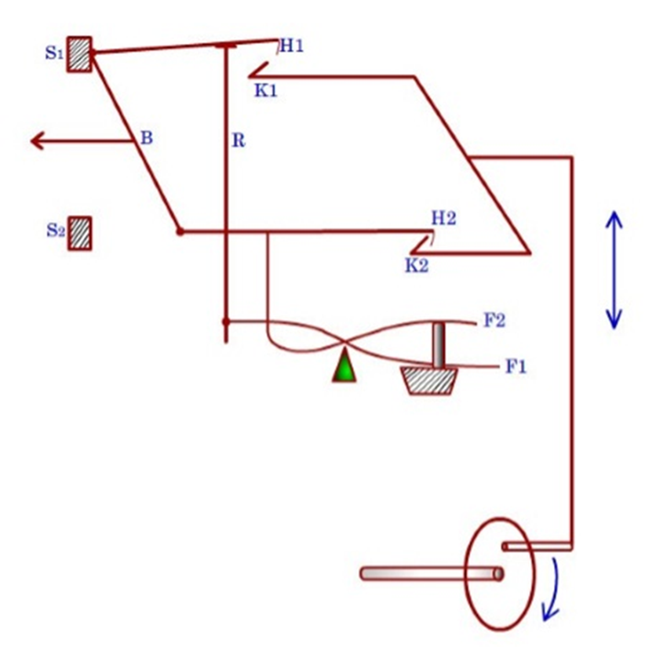
The knife 2 (K2) has pulled hook 2 (H2) towards the right side. This has happened as there is a peg in the lag corresponding to the feeler 2 (F2).
The peg has pushed the right end of the feeler 2 in the upward direction. Thus the left end of the feeler 2 has been lowered.
So, the hook 2 was also lowered on knife 2 when the latter moved inward. So, the lower end of the baulk (B) moves away from the stop bar 2 (S₂). Thus the heald shaft is raised as it is connected at the midpoint of the baulk.
In the next part of the cycle, knife 2 will move inward and knife 1 (K₁) will move outward. Now, there is no peg corresponding to the position of feeler 1 (F₁). So, right end of feeler 1 is lowered and left end of it is raised. As a result, the connecting rod (R) has pushed the hook 1 in the upward direction. So, when the knife 1 will perform its outward movement, it will not be able to catch the hook 1. The top part of baulk will be resting on stop bar 1 and thus the heald will not be lifted for the next pick.

Slide 6
It is important to note here that when the heald is in lower position for two consecutive picks, the top as well as the bottom end of the baulk will be resting on the respective stop bars i.e. S1 and S2. So, the midpoint of the baulk will not have any significant movement.
On the other hand, if the heald is in raised position for two consecutive picks, then one end of the baulk will move away from the stop bar and another end of the baulk will move towards the stop bar. Thus the middle point of the baulk will not experience any significant movement as schematically shown in Figure. Thus the amount of wasted movement is very nominal. Therefore, the system will produce open shed.
The selection for heald movement is controlled by wooden pegs which can be inserted within the circular holes made on the wooden lags.
The wooden lags inked together into a lattice which is mounted on the pattern wheel (or barrel).
The pattern barrel is rotated by a certain degree once in two peaks. For example, if the barrel is hexagonal then it must rotate by 60° after every two picks.
The presence of a peg within the hole results raised position of the heald and vice versa.
The position of two holes corresponding to the same heald is not on the same line. The lateral shifting of holes is done so that two adjacent feelers can be accommodated.

Slide 7
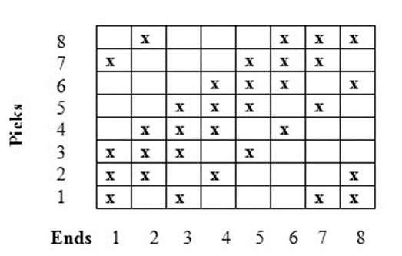
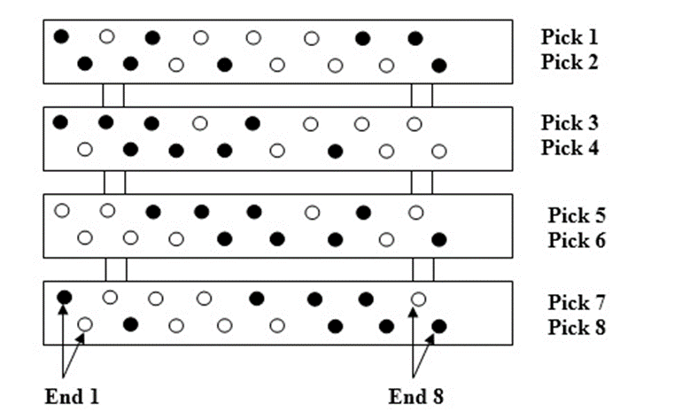
System of Pegging

Slide 8
Preparation of lattice for a left-hand dobby

Slide 9
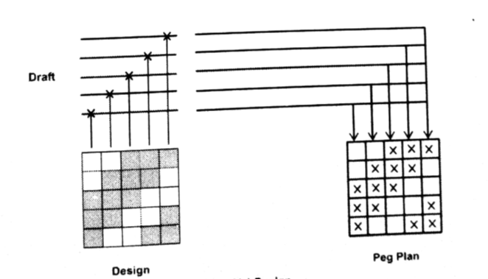
Preparation of lattice for a Left-hand dobby

Slide 10
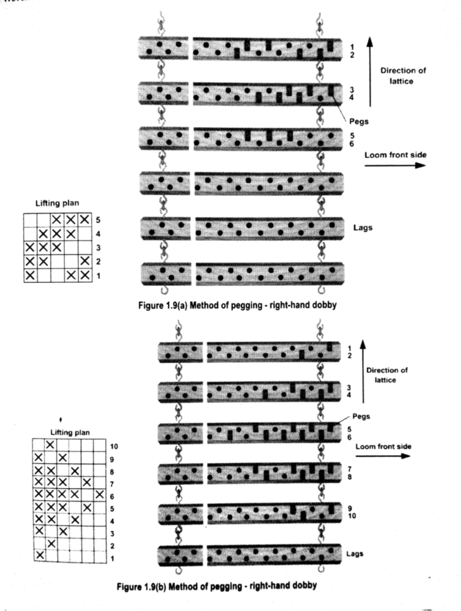
Preparation of lattice for a Right-hand dobby

Slide 11
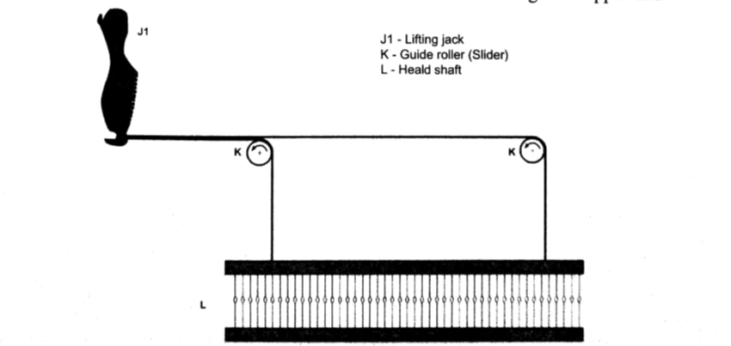
Cam Dobby

